Slide 1
Local Search Algorithms for Scheduling Vehicles in Cyclic Flexible Manufacturing Systems
Martin Gutjahr

Slide 2
Contents
General overview of the basic concept of the problem regarded
Description of the approach made
Implementation of the heuristic
Evaluation of achieved results

Slide 3
General Overview
Automated Guided Vehicles
  Vehicles are self-driving
  Fully autonomous except for routing and service
Cyclic Flexible Manufacturing System
  Vehicles on set track
  Multiple Machines at each stage

Slide 4
General Overview (2)
Regarded Problem
  Jobs have to be transported between machines
  Minimize total time needed
  Minimize amount of vehicles needed

Slide 5
Parameters and Variables
Parameters
  Amount of production stages 10
  Machines per stage varying
  Transportation time between stages 2
  Amount of jobs 25
  Schedule of jobs on machines perm.
  Processing times of jobs on machines varying
Variable
  Starting time of each vehicle
  Pickup of jobs by vehicle
  Processing of jobs by machines
  Completion time of each job

Slide 6
Approach
Heuristical Approach needed
  Local Search
    Starting times change by a single unit of time
    Runs until solution cannot be improved in neighbourhood

Slide 7
Approach (2)
Multidimensional objective function
  Pareto Front
    Solutions for different vehicle numbers stored seperately
    Function (e.g. cost) can be used to pick preferred solution

Slide 8
Approach (3)
Local Search variations
  Differences in the Perturbation phase
    Instances vary in perturbation strength or are generated randomly
  Differences in the amount of iterations
    Each heuristic has a set amount of perturbations

Slide 9
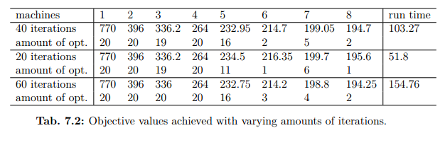
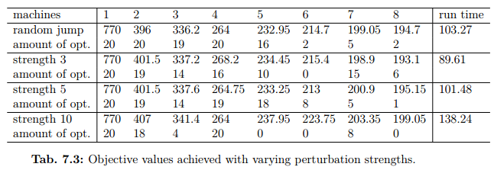
Evaluation of achieved results
Base for
benchmark
40 it./rand

Slide 10
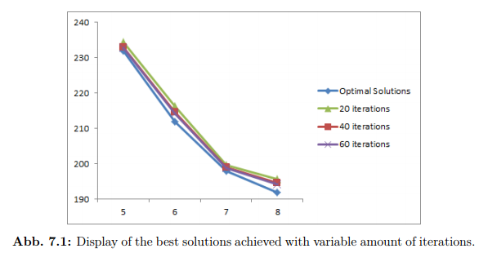
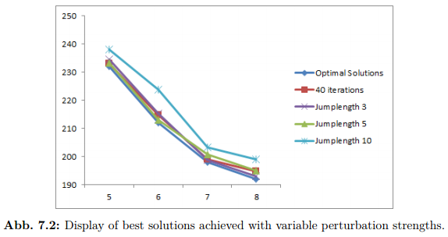
Evaluation of achieved results (2)
Random Jump
variable iterations
Random jump vs.
set jump length

